Slide 1
FOOD MANIA
Andriod Application
Final Project Proposal

Slide 2
CONTENT
Introduction of the Application
Targeted Audience
Problem Definition
Proposed Solution
Business Plan
Functional Requirements
Non- Functional Requirements
Benefits
Group Members

Slide 3
Introduction of the Application
Food ,
is the basic human need to stay alive.
Moreover, it is the need of every living organism.
Nowadays food has become trending among the society,
Because of that people are willing to try different kind of dishes.
Therefore, it is better to have a social platform which allows to
sell, buy, and share their food ideas.

Slide 4


Targeted Audience
We can keep our focus on restaurants to expand their marketplace.
Young generation likes to try out various tastes.
content-creators who create food recipes.
People who are willing to sell their cooking skill and all other food lovers.

Slide 5
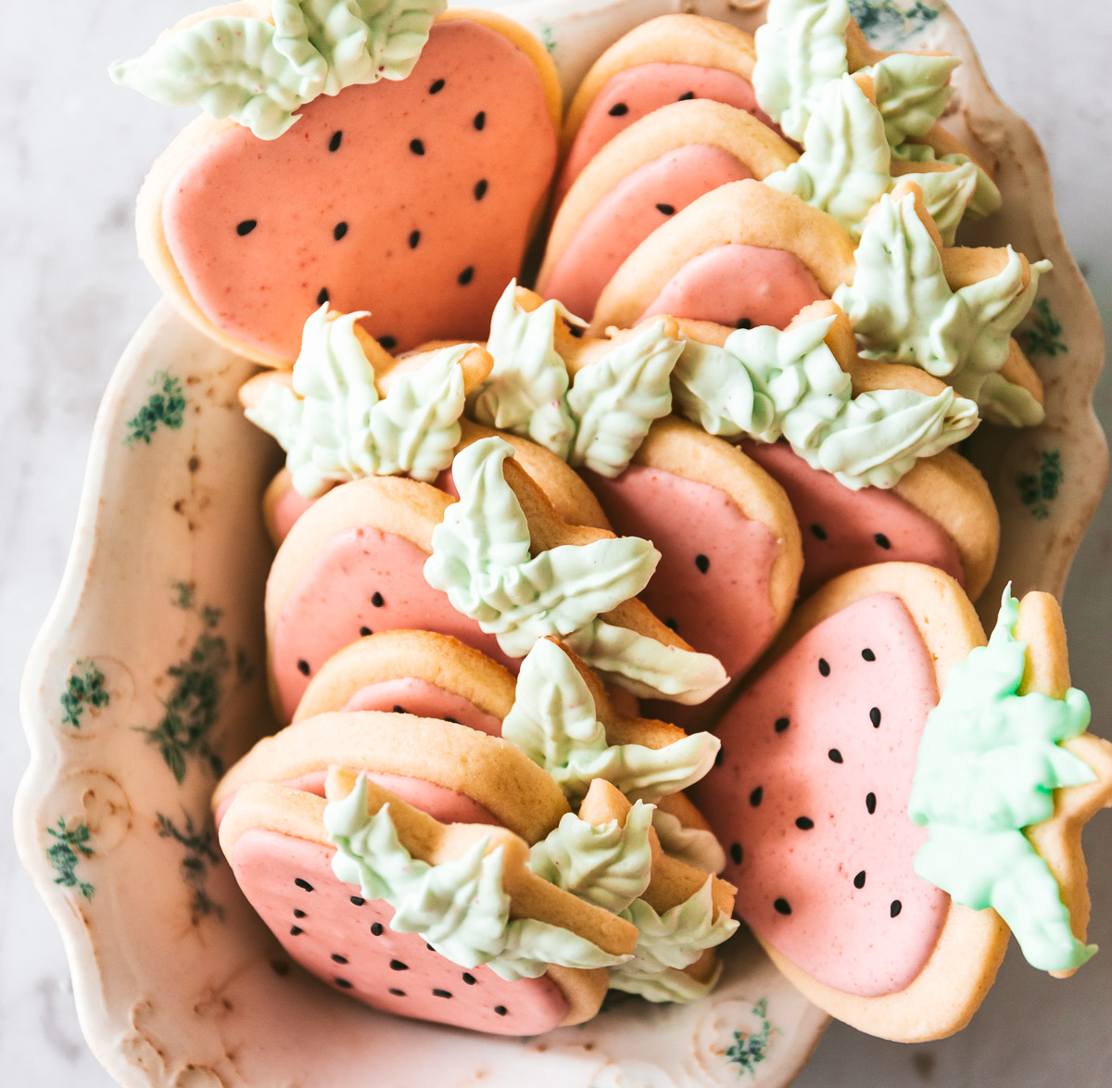
Problem Definition
There is no proper digital application to hire a chef as soon as you needed.
Not only that, but there is also a lack of social platform which provides all buying, selling, hiring, sharing food related things in one place.

Slide 6
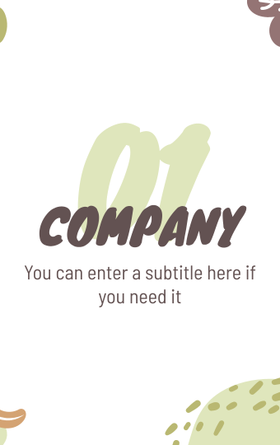

Proposed Solution
We are hoping to develop an android application called “Food Mania” which allows to
Create user accounts
Share food recipes
Perform businesses activities
Share photos, stories, videos
Sell your cooking skills
with the friends and followers, you care about.

Slide 7

Business Plan
Market Analysis
SWOT Analysis
Marketing strategy
It makes a bridge that allows your product to fall into the hands of your customers
Gathering information about the state of the market
Competitors
Creating a competitive analysis to understand the other competitors and their strengths and weaknesses.
Strengths,
Weaknesses,
Opportunities,
Threats.
Company Overview
Financials
The financial model includes, as a rule, a three- to five-year forecast of all the main forecasted models, including profit and loss, cash flow, balance sheets, start tables, and valuation.
- Type of business structure
- Team/remote team
- Problem and mission
- Statement of the concept

Slide 8

Functional Requirements
Login and Registration –
People can login as a normal user or a business
user (restaurants and shops) or a skill seller by
creating a user account.
Mange user account–
User can customize the account according to his/her dietary preference and they can manage their personal profile information along with the user image.
Save to favorites–
Users can save their favorite posts, videos, recipes etc. along with
their user account.

Slide 9
Manage news feed –
By using “Food Mania” app you can connect with friends, share what you are up to, or see what is new from others. It will suggest posts to your news feed as you preferred and according to your followers. Food mania app makes it even easier to find the best recipes, watch incredible food videos and cook delicious meals.
Place orders –
Users can contact a range of restaurants and suppliers to order the cuisine and food items they crave according to their dietary preference any time of the day by dropping a direct message.
Skill selling and buying –
Users can hire a skill seller such as a chef, cake baker and many more, by using the location.

Slide 10

Browse restaurants –
Users can browse Restaurants and Suppliers within their vicinity by using the location to search for food according to item name and type of dish.
Video conference –
Users can use video conference
feature for live stream, conduct
classes for food lovers and any
other entertaining stuff.

Slide 11

Non-Functional Requirements
Performance –
This is a simple and lightweight android application.
Portability –
This application can be downloaded easily from Google play store.
Security –
We maintain three separate user profiles for normal users, business users and skill sellers.
Unauthorized users should not be able to access the application.
Irrelevant posts and profiles will be automatically banned.

Slide 12
Maintenance –
We would be able to do all the new updates according to the technology change.
By considering the customer reviews, we will update the app to continue a well maintenance.
Reliability –
The application will run with less failures.
The definition of a failure will be clearly identified by using validations and exception handling.
We will specify the consequences of application failure, how to protect from failure, a strategy for error detection, and a strategy for correction.

Slide 13
Benifits
Food lovers can use this app as a social media platform to share posts, stories videos to their followers.
Users can find restaurants by using their locations and they can directly drop a message to that restaurants and shops for any queries.
If there are any content creators that create recipies or new experiments, they can share their ideas thourgh ‘’Food Mania”.
Users can quickly find the nearest chef they want, and it makes a good platform for those who want to sell their culinary skills.
There is an additional feature to conduct video conferences. Along with that users can conduct online classes to share their cooking knowledge with friends.

Slide 14
Group Members
COHDSE201F- 011 A. D. M. L. Aluthge COHDSE201F- 040 H. P. K. G. Pathirana COHDSE201F- 041 Y. D. Ranasinghe COHDSE201F- 042 V. T. Mohotti

Slide 15
THANKS!
Higher National Diploma in Software Engineering 20.1F
National Institute of Business Management - Colombo 07

